Slide 1
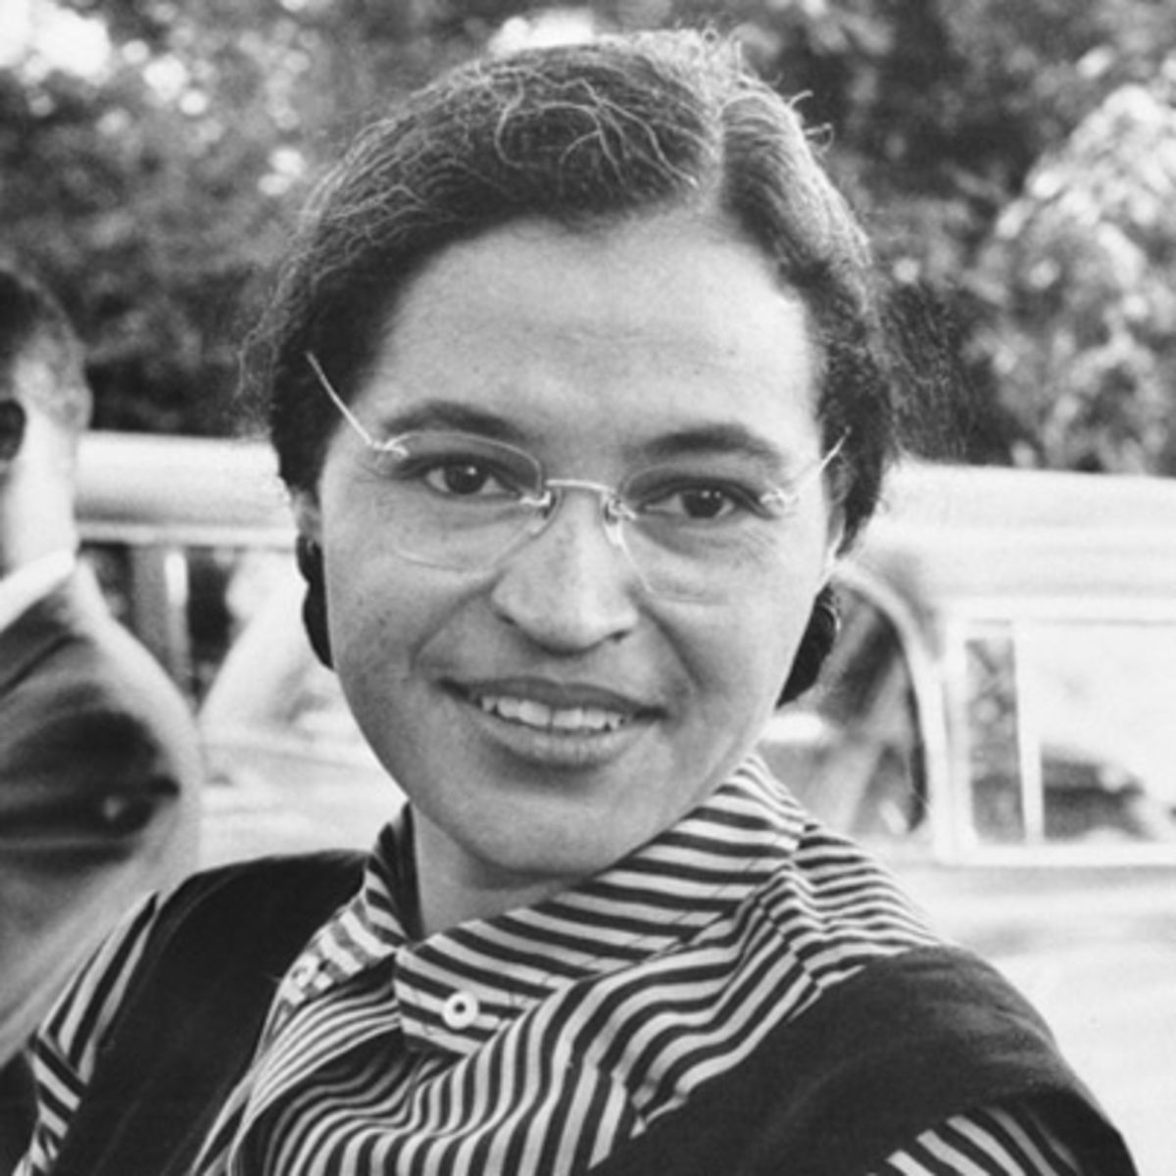
Rosa Parks
Civil rights activist Rosa Parks refused to surrender her bus seat to a white passenger, spurring the Montgomery boycott and other efforts to end segregation.

Slide 2
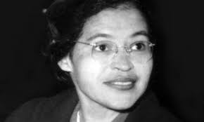
Background Information About Rosa Parks
FULL NAME
Rosa Louise McCauley Parks
OCCUPATION
  Civil Rights Activist
BIRTH DATE
  February 4, 1913
DEATH DATE
  October 24, 2005
EDUCATION
  Industrial School for Girls, Alabama State Teachers College for Negroes
PLACE OF BIRTH
  Tuskegee, Alabama
PLACE OF DEATH
  Detroit, Michigan

Slide 3
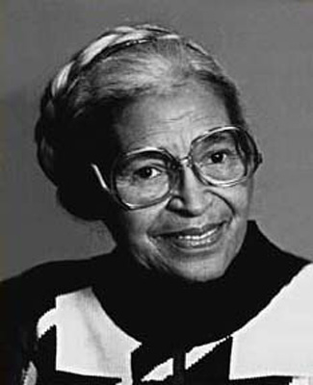
Who Is Rosa Parks?
Most of the faces we know from the Civil Rights struggle are images of young, bold, idealistic people. When Rosa Parks made the choice not to leave her seat on a segregated bus, this was not the choice of a young idealist. Nor was it one of a woman unfamiliar with the fight for civil liberties. Parks was in her forties, already a wife and mother. Both Parks and her husband were involved with the NAACP and the Voter's League. The two even raised money to support the Scottsboro boys, a group of young men who had been falsely accused of raping two white women.

Slide 4
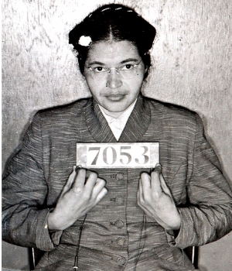
10 Things You May Not Have Known About Rosa Parks
1. Parks was not the first African-American woman to be arrested for refusing to yield her seat on a Montgomery bus.
2. Parks was a civil rights activist before her arrest
3. Parks had a prior encounter with James Blake, the bus driver who demanded she vacate her seat.
4. Her act of civil disobedience was not pre-meditated.
5. Parks was not sitting in a whites-only section.
6. Parks did not refuse to leave her seat because her feet were tired.
7. Weeks after her arrest, Parks was jailed a second time for her role in the boycott.
8. Parks was forced to move from Montgomery soon after the boycott.
9. Parks was the first woman to lie in state at the U.S. Capitol.
10. Bus seats were left empty to honor Parks on the 50th anniversary of her arrest.

Slide 5
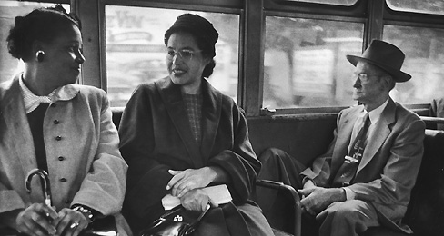
How Did Rosa Parks Impact The World?
Her action in Montgomery, Alabama, on Dec. 1, 1955, was intended to be a small protest.
“I had no idea that when I refused to give up my seat on that Montgomery bus that my small action would help put an end to segregation laws in the South,” Parks wrote in her autobiography for kids, “Rosa Parks: My Story.” “I only knew that I was tired of being pushed around.”
She was arrested and found guilty of violating segregation laws, rules that required black and white people to attend separate schools, drink from separate water fountains and sit in separate areas on buses. Lawyers filed a court case challenging the fairness of segregating buses. The U.S. Supreme Court decided that it was against the Constitution, and black people in Montgomery were allowed to sit in any bus seat. That victory led to many other challenges to segregation laws in the United States.
Parks became a hero of those fighting for equality for blacks. She died in 2005, and three schools in the Washington area are named in her honor.

